Slide 1
DRIVER SAFETY P.A.S.S. System™ Driver Training
Tom Donovan, M.S.
Battalion Chief, PFD (retired)
Member ADTSEA
trdfcu@juno.com

Slide 2
COURSE OVERVIEW
Introduction
Statistics – The Problem:
Why You Need To Be a Better Driver
Causes of Vehicle Crashes
Changing Driving Behavior to Reduce Your Crash Risk
Miscellaneous Issues
Modifying Habitual Behavior
Conclusion

Slide 3
Driver Safety
Whether you are an excellent driver or not, you still must accommodate your driving to handle all the noticeably bad drivers on the road today.
I will argue in this class that it is worth your time and effort to be a safer driver.
The logistics or specific behaviors of being a very good driver are quite simple and easy to remember.
The hard part is: the application of doing what you know you should do - primarily by just remembering to do it.
“That which I would do, I do not. That which I would not do, I do.” Saint Augustine.

Slide 4
Driver Safety
I apologize if my directness offends anyone’s sensibilities, BUT:
The truth is that when it comes to our diving habits most of us need a wake-up call.
Driving on our roadways today is not a case of: “I’m OK - you’re OK,” or “Do your thing.”
The truth is more like: “I’m dangerous, and you’re probably stupid.”
That is the situation we each need to accept and deal with in a straight forward and honest way.
Otherwise we are likely to end up as one of the statistics we are about to go over.

Slide 5
Driver Safety – the “Numbers”
Following are the numbers that show how dangerous it is to drive on U.S. roads.
You have probably already noticed a lot of bad driving around you.
Unfortunately noticing bad driving by others does not mean you will be a more careful driver yourself.

Slide 6
Driver Safety – the “Numbers”
Please realize that for vehicle crashes each single number is a real person: a mother, a child, a loved family member, a wage earner.
These are people I have seen crushed,
maimed and killed by drivers who were negligent:
i.e., Drivers who did not make the effort to drive responsibly.
These are drivers who basically Don’t Think about their driving.
And to some extent that is each one of us.

Slide 7
Driver Safety – the “Numbers”
Death by vehicle is the 5th leading cause of death in the U.S.
Loss of life by vehicle is the leading cause of early death. [35 and under]
Presently in the U. S. the annual number of individuals killed in or by vehicles is around 40,000.
Annual serious injuries at about 2,575,000 people. [NHTSA, 2006]
D.O.T. reported 4,800,000 injuries in year 2000.
Result of 16.4 million reported crashes (191 million drivers).

Slide 8
Driver Safety – the “Numbers”

Slide 9
Driver Safety – the “Numbers”
What do such numbers mean?
Annual serious injuries on our roadways exceeds the total number of U.S. soldiers injured in the U.S. Civil war and W.W. II combined!!
The annual death total on our roads equals 125% of the total of U.S. soldiers killed in the Korean War.
More Americans are killed every 18 months on our roadways than died during the entire Viet Nam War.
Death on our roads surpasses all the U.S. soldier fatalities in the current wars in Iraq and Afghanistan every 45 Days.

Slide 10
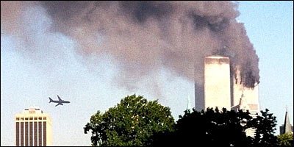
Driver Safety – the “Numbers”
More die on our roads each year than die of breast cancer yearly.
One 9-11 event EACH MONTH!!!
Plus over 200,000 serious injuries each month.

Slide 11
Driver Safety – the “Numbers” Equivalent to Nagasaki atomic bomb blast every two years.

Slide 12
Driver Safety – the “Numbers”
Realize this topic is not about “other” people; it’s about you and your risk.
In 1960 we ranked first in fewest deaths per registered vehicle worldwide.
In 2002 U. S. ranked 16th in the world - fewest deaths per registered vehicle.
We are going in the wrong direction.

Slide 13
Driver Safety
We attempt to absolve drivers – ourselves – of responsibility by calling a crash or collision an “accident”?
You may not believe that you intended to hit the car in front of you when it slowed or stopped, but your failure to control your vehicle made that collision take place.
The collision is your fault; it was not an “accident.”
You are required to be in control of your vehicle at all times – not sometimes, not just when you decide to pay attention:
AT ALL TIMES!

Slide 14
Driver Safety

Slide 15
Driver Safety
The first step to becoming a better driver is admitting you are responsible for controlling your vehicle.
I have never responded to a collision that was not at least one driver’s fault; NEVER.
“No fault” collisions are a myth.
By accepting your responsibility you will start behaving in a way that will greatly protect yourself and those driving with you.
Other people’s bad driving behavior is not going away.

Slide 16
Causes of Vehicle Crashes
Leading causes of vehicle crashes :
Lack of attention - eating, cell phones, kids, radio, grooming, daydreaming, etc.
Lack of Space.
Speeding (including driving too fast for conditions).
Alcohol impaired driving.

Slide 17
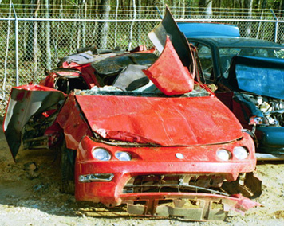
Causes of Vehicle Crashes
You will come close to eliminating your probability of having a wreck if:
You learn to avoid these major, easily identifiable unsafe driving practices/habits.
Unsafe driving practices = driving behavior linked to collisions.

Slide 18
Causes of Vehicle Crashes
LACK OF ATTENTION:
sometimes defined as “distracted driving”
2006 NHTSA study reported that 78% of vehicle cashes involved some component of “distracted driving.”
Inattention to one’s driving is the single biggest contributor to having a collision – including big, bloody collisions.
It is also something to which every driver is prone.
Simple lack of attention to the job of driving.

Slide 19
Causes of Vehicle Crashes - Inattention
Cell phone use – including hands free phone use.
Cell phone use makes you as bad a driver as one legally intoxicated.
It marks you as irresponsible and/or not too bright.
Being deliberately dumb and irresponsible comes with costs (eventually).
Do you really want to pay those costs (physical, psychological & financial)?
There is a reason states make cell phone use illegal.

Slide 20
Causes of Vehicle Crashes – Inattention [click on video icon below]

Slide 21
Causes of Vehicle Crashes - Inattention
Hand held computers/ text messaging:
If you think you can use these devices and drive, you should turn in your driver’s license today and look for other means of transportation.
2006 Nationwide Insurance study found 19% of drivers admitted texting.
“Texters” are on the road, and are a danger to themselves and you.
Shouldn’t you be paying attention to them?
And don’t think that if you are not “texting,” only using your cell phone, you are somehow acting responsibly.

Slide 22
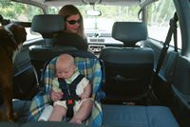
Causes of Vehicle Crashes - Inattention
Interaction with passengers:
Most important with children and infants.
“Passenger distraction” collisions are eight times more frequent with an infant in the car.
We tend to pay more attention to our children and infants than to adults.
And the young are probably more distracting by their (active) behavior.

Slide 23
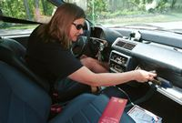
Causes of Vehicle Crashes - Inattention
Handling & fiddling with objects and controls.
This behavior causes you to take your eyes and attention off the road in front of you.
And attend instead to:
Radio/cd/tapes, navigation system, personal hygiene, eating, smoking, reading, etc.
Are these really activities you should be doing while driving?
Yes, if you want to CRASH!

Slide 24
Causes of Vehicle Crashes – Inattention [This driver was playing with CD’s]

Slide 25
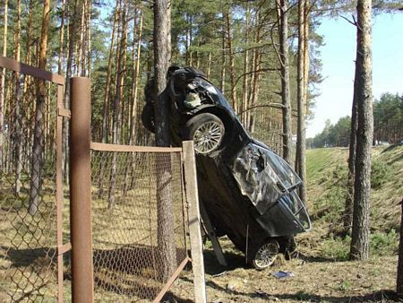
Causes of Vehicle Crashes - Inattention
Wandering thoughts/eyes (as opposed to paying attention to the road & your driving):
Don’t look at the view!
That is for passengers, not the driver.
Don’t think about your problems, your life:
You may end up with more problems, or no life.

Slide 26
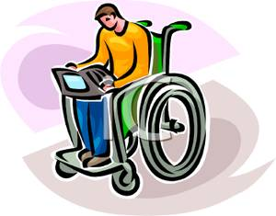
Causes of Vehicle Crashes - Inattention
All the mentioned distractions lead to increased reaction times.
Small increases in reaction times lead to unnecessary, avoidable crashes.
Small increases in reaction times (half seconds) can produce large increases in collision severity.
Distractions can be deadly and crippling.
Is your home equipped for wheelchair access?

Slide 27
Causes of Vehicle Crashes
Speeding:
When you speed you significantly increase your chances of a serious crash.
Crash severity increases by the square of the speed.
As your speedometer goes up, you get to watch your chances of being in a crash go up.
MORE SPEED=MORE DANGER
Also, increased speed lessens your traction and maneuverability.
One third of driver fatalities involve speeding.

Slide 28
Causes of Vehicle Crashes - Speeding [This driver was speeding]

Slide 29
Causes of Vehicle Crashes - Speeding
In 1974, U.S. interstate highways broadly reduced speed limits to 55 mph to save energy.
A national drop in traffic fatalities followed from 54,000 dead Americans to 45,000.
The actual observed speed decline was 5.8 mph – 63.4 to 57.6 mph.
A drop of 9,000 fatalities and approx. 580,000 serious injuries in one year.
Many of us are alive or uncrippled today because of that speed change.

Slide 30
Causes of Vehicle Crashes - Speeding
Following the 1970’s energy crisis U.S. states increased speed limits.
Those states increasing limits from 55 to 65 mph achieved an average 10% increase in fatalities.
States increasing speeds to 70mph achieved a 35% increase in fatalities.
States increasing speeds to 75 mph killed 38% more people:
Bravo! to those state representatives elected to protect the public.

Slide 31
Causes of Vehicle Crashes - Speeding
Multiple Speed Studies – Overview:
A one percent increase in speed is believed to increase fatality risk in the range of 4 to 12%.
Using the lower end 4% figure, a 10% increase in your speed yields a 40% increase in your risk of killing someone – maybe yourself.
e.g., 60 mph to 66 mph
Increasing your speed from 60mph to 72 mph gives an 80% (nearly double) risk of creating a fatality.

Slide 32
Causes of Vehicle Crashes - Speeding
In 2003, 27 U.S. states offered cars for sale with top speeds up to 240 mph.
Quickest way to kill a young driver: give them or help them buy a “fast” car.
A truly loving gift!
Excess Speed kills, cripples and destroys peoples lives.
We all need to reconsider our attitudes about it.

Slide 33
Causes of Vehicle Crashes - Speeding

Slide 34
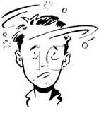
Causes of Vehicle Crashes Alcohol
Alcohol:
Alcohol is a nervous system depressant, it slows/suppresses/interferes with nerve function.
In 2002, over 16,000 vehicle fatalities were alcohol related.
About 40% of total annual fatalities.
The more severe a crash, the more likely alcohol was involved.
Alcohol works quickly to distort depth perception, and it adversely affects focus and peripheral vision.

Slide 35
Causes of Vehicle Crashes - Alcohol
Drivers do things under the influence of alcohol that they would not do if completely sober.
Thus alcohol influenced driving is more than just the impairment of driving skills.
Drinking drivers make poor to bad decisions.
Alcohol influenced drivers tend to accept higher risks and higher speeds.

Slide 36
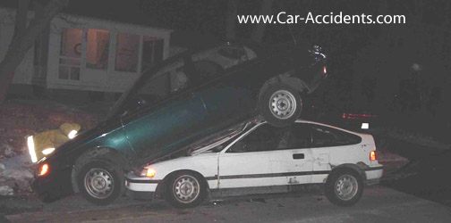
Causes of Vehicle Crashes - Alcohol
Roughly equal amounts of alcohol in 12 ounce beer, 4 ounces wine, or 1.27 ounces 80 proof liquor (Evans).
Rule of thumb: one regular beer = one regular wine = one shot of liquor.
Remember many cocktails/mixed drinks have more than one shot.

Slide 37
Causes of Vehicle Crashes - Alcohol
The approximate rate at which alcohol is metabolized is .015 B.A.L. units per hour.
However this varies widely among individuals and is dependent on many factors.
B.A.L. varies (per drink) with weight of the person.
The following information is highly generalized; i.e., your case may be very different.

Slide 38
Causes of Vehicle Crashes - Alcohol
Two standard alcoholic beverages give an average size person peak B.A.L of .045%
Result: judgment altered, lowered alertness, reduced reaction time.
Dangerous combination for a driver.
Any measurable B.A.L. will adversely affect driving behavior.

Slide 39
Causes of Vehicle Crashes - Alcohol
In all U.S. states the B.A.L. defining DUI, “drunk driving,” is .08%
Realize that “drunk” is a term with no precise definition.
The .08 level is arbitrary and influenced by lobbyists.
The truth is that you are significantly impaired as a driver long before reaching the .08% B.A.L.
You may feel good and be a lot of fun, but don’t drive.
Nearly half of all alcohol related fatalities involve drivers with less than a .08 B.A.L

Slide 40
Causes of Vehicle Crashes - Alcohol

Slide 41
Causes of Vehicle Crashes - Alcohol
.04 B.A.L. is the DUI standard for commercial drivers in many states.
In PA .02 B.A.L. in person under 21 yr. old is legal intoxication; i.e., DUI (DWI).
Two drinks can get a 120 lb. female to the DUI .08 B.A.L.
Three beers can get a 140 lb. male to DUI .08 B.A.L.
Remember: A woman gets drunk faster and sobers up more slowly than a man.

Slide 42
Causes of Vehicle Crashes - Alcohol
Penalties in Pennsylvania: Driver under 21 years of age with B.A.L .02 and up gets two days to 6 months in prison, plus fines & court costs.
Adult driver with B.AL. .1 and up: first offense 2 days to 6 months; second offense 30 days to 6months – plus fines and court costs.
B.A.L. .16 and up gets you up to 5 years with Bubba plus big fines and court costs.
You want to fight your DUI charge with a DUI lawyer? How much $money have you got?
But shouldn’t your real concern be that 40% of traffic fatalities are alcohol related??
Plus 1 million serious injuries! Each year!

Slide 43
Causes of Vehicle Crashes - Alcohol

Slide 44
Causes of Vehicle Crashes - Space
Lack of Space around vehicles is a leading cause of collisions.
Tailgating.
Failure to maintain lane position.
Failure to yield right-of-way.
Space around your vehicle gives you time to react when others drive badly or do the unexpected.

Slide 45
Causes of Vehicle Crashes - Space

Slide 46
Causes of Vehicle Crashes - Space
SPACE protects you from alcohol impaired drivers.
Space also protects you from your mistakes (and we all make them).
Your state drivers manual has excellent information on maintaining space around your vehicle.
SUV’s and pick-up trucks need 10-20% more distance to stop than passengers cars.
Large trucks need twice the distance to stop at 55 mph.

Slide 47
Causes of Crashes – Aggressive Driving
People have a built-in bias towards believing that their personal risk is lower than that of others.
We do not see ourselves as getting killed or injured despite regular news reports to the contrary.
Death and dismemberment is what happens to the “other” person – not you.
Why??
“If you have not lived through something then it is not true.” Kabir

Slide 48
Causes of Crashes – Aggressive Driving
Not believing we are at risk allows us (in our deluded minds) to drive badly and aggressively.
We believe we are in control.
We believe we are the masters of our fate (as we talk on the cell phone, speed, tailgate, and drive home from the local bar).
The idea that we are “in control” in our vehicles versus being in an airplane explains why so many people feel safer driving then flying a commercial airliner.

Slide 49
Causes of Crashes – Aggressive Driving
In fact, you are 70 times safer (by distance travelled) in a commercial airplane than on our deadly roadways.
When 58 people died in the Feb., 2009, plane crash outside Buffalo, NY, many people had a reaction to that event.
But probably No One, other than those personally effected, had a reaction that day to the over 100 just as important individuals that died on U.S. roads that same day.
And each day throughout the year on U.S. roads.
44,000 collisions (one every 1.97 seconds); 7,000 seriously injured; 112 dead.

Slide 50
Causes of Crashes – Aggressive Driving
I have not found any good statistics on aggressive driving, and one reason probably is that aggressive driving is not easy to define.
Nevertheless we all know what aggressive driving looks like when we see it.
And we usually don’t like it.
Although we do not seem to have a problem doing it ourselves when it suits us.
Because we don’t see ourselves as aggressive.
What we do makes sense.

Slide 51
Causes of Crashes – Aggressive Driving [click on video icon below - Video #4; first scene only – example of the results aggressive driving]

Slide 52
Causes of Crashes – Aggressive Driving
Examples of aggressive driving you should consider:
Speeding. Yes, speeding is aggressive driving – you are going too fast, that’s AGGRESSIVE!
Tailgating.
The most common (and DUMB) aggressive driving behavior.
Also the best way to ensure a collision in your future.
Running red lights.
Frequent/Abrupt lane changes.
Another great way to ensure a big crash in your future.
Failure to let other vehicles merge.

Slide 53
Causes of Crashes – Age/Inexperience
Death by vehicle crash is the leading cause of death in the U.S.A. for ages 2-35 years.
We loose more teenagers (age 13-19) to traffic crashes each year than the total annual fire fatality count in this country.
16 year old drivers crash 10 times more often than 40-50 year olds (same distance travelled).
One out of seven 16 yr. old drivers crashed in 2005.
Drivers under 25 years of age represent 15 % of U.S. drivers, but account for 30% of our fatalities.

Slide 54
Causes of Crashes – Age/Inexperience
In every country studied, vehicle collisions are disproportionately a problem of young male drivers.
The curve showing male collisions by age is nearly identical to the curve of male arrests by age.
The collision curve is very high for 16-23 year old drivers, then tapers off steeply to age 30.
Young female drivers have a similar pattern to young male drivers:
i.e. more fatalities/collisions in the 16 to 23 year old bracket, but at a much lower rate (1/4 to 1/3) than male drivers.
Pennsylvania is the 4th worse state for young driver deaths [following CA, FL, & TX].

Slide 55
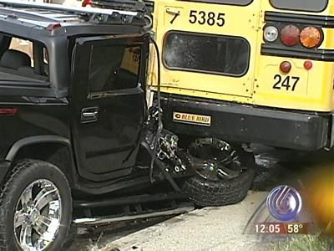
Causes of Crashes – Age/Inexperience
A study of 2,000 vehicle crashes involving 16-19 year olds found four main problem areas.
Errors in attention caused the majority of non-fatal crashes.
Poor visual search (scanning for hazards).
Excess speed (over the limit).
Poor hazard recognition: inability to define/identify high risk situation even when seen by the eyes.

Slide 56
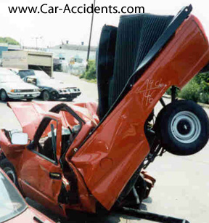
Causes of Crashes – Age/Inexperience
Conclusion: inexperienced drivers need to be particularly careful in overcoming their limitations.
Clearly you have to be at your best when driving because the roads are filled with young, inexperienced drivers.

Slide 57
Causes of Crashes – Tired Driving
Tired/Drowsy Driving
Similar effects on drivers as alcohol impairment.
Triples your risk of a crash.
NHTSA estimates there are approximately 100,000 police reported crashes annually caused by sleeping drivers.
Not sleepy drivers but drivers actually asleep at the wheel.
Yet 62 % of drivers drive tired.
Studies show tired eyes have poor glare recovery.
And if you can’t see well you are at risk of running off the road or hitting something.

Slide 58
Possible Result of Your Next Crash

Slide 59
Changing Behavior to Reduce Risk
We have covered the six major driving behaviors that lead to vehicle crashes.
Now, how do we change these behaviors?
How do we avoid the “near occasion” of smashing up and suffering irreparable harm?
We will need to change specific behaviors for each of the major causes of crashes.

Slide 60
Changing Behavior – Drowsy Driving
First principle here is be aware that this is a problem, then – deal with it!
Have someone else drive.
Stop and rest.
Plan better to avoid the situation from arising.
Look out for your friends and family.
Do not drive with a tired driver.
Do not drive if taking medication causing drowsiness.

Slide 61
Changing Behavior – Drowsy Driving
Remember you want to avoid your risk of a collision.
Why gamble with fatigue?
You say you have no choice?
WRONG!
You always have a choice; it may not be convenient, it may be difficult.
But retooling your life, even in big ways, will be easier than learning to live without the use of your arms or legs.

Slide 62
Changing Behavior – Age/Inexperience
Graduated Driver’s Licensing (GDL) programs have been shown to reduce crash rates of young and inexperienced drivers.
All beginning drivers should take a driver education course either at school or with an accredited private firm giving classroom and on road instruction.
Parents/Guardians should make a serious effort to set a good example by improving their own driving behavior and risk awareness.
Parent teaching should not end with full licensing.

Slide 63
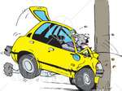
Changing Behavior – Age/Inexperience
Young drivers need to be educated into an awareness that they are at risk when driving similar to being at risk for a sexually transmitted disease.
They need to take precautions to combat their inexperience.
They must practice the major factors in crash prevention:
Pay Attention
Alcohol restraint
Speed control
Space between vehicles
P.A.S.S.!

Slide 64
Changing Behavior - Space
Space: It is your responsibility at all times to not crash into the vehicle in front of you.
No matter what dumb or unpredictable move the driver ahead of you makes.
Look ahead and plan your moves in relation to the traffic on the road.
Anticipate bad moves by other drivers.
Scan for vehicles and people entering the road.
Be on the lookout for slow moving or stopped vehicles.
You can’t run into them just because you didn’t “think” they would stop.

Slide 65
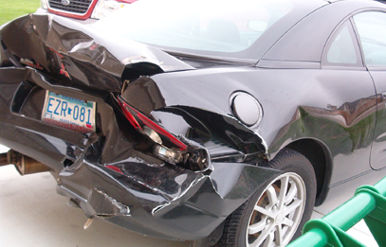
Changing Behavior - Space
Tailgating is a habit, like most bad driving behaviors.
We object to being “cut in front of” so we believe tailgating is essential.
Being pushed back in a line of traffic is seen as an affront to one’s dignity.
Get over it - engage your Intelligence!
Pay attention to your driving and STOP TAILGATING!!

Slide 66
Changing Behavior - Space
To eliminate your chance of being hit from behind:
Use a gradual deceleration when approaching red traffic lights, and stopped or slowed vehicles.
As opposed to slamming on your brakes at the last second.
This is a $$-saver: brakes, gas, insurance.
To do this you will need to be looking ahead and paying attention.

Slide 67
Changing Behavior - Space
It is critically important to pay attention to your space on highways where the “slinky” effect is frequent.
i.e., traffic congestion, road repairs, etc., that lead to rapid deceleration in traffic ahead of you.
Here your vehicle is prone to a rear-end collision as you stop/slow quickly.
Your protection is the Safe Space you maintain in front of you at all times.

Slide 68
Changing Behavior - Space

Slide 69
Changing Behavior - Space
Remember stopping distance has three components:
Perception distance.
Reaction distance.
Braking distance.
Larger truck has twice the braking distance of a passenger car.
275 feet versus 142 feet at 55 mph.
If you stop quickly with a tractor trailer close behind you, guess what happens?

Slide 70
Changing Behavior - Space

Slide 71
Changing Behavior - Space
Sometimes other drivers stop suddenly because of something in front of them you cannot see; e.g., a pedestrian, an animal, an object in the roadway.
You need time and distance to react to this unexpected event.
Thus you must have enough SPACE in front of you AT ALL TIMES to be able to react.
Control the space IN FRONT OF YOU and you will never have to stop too quickly.

Slide 72
Causes of Vehicle Crashes - Space
Use the four-second rule to calculate the proper safe following distance (PDM).
Calculate four seconds of following distance by counting the seconds it takes your car to reach a marker passed by the vehicle in front of you.
The 4-second rule [for good road and driving conditions] is based on maximizing your safety.
Four-second rule at 60 mph gives a following distance of 350 feet (116 yards).

Slide 73
Changing Behavior - Space
AAA recommends a 3-second following distance up to 50 mph on dry pavement with good visibility and a safe escape route to the side.
In less than ideal conditions or going over 50 mph AAA recommends more space, 4-8 seconds.
For example:
Traction or visibility is reduced.
You are distracted.
A driver behind you is trying to pass.
Following motorcycles.
Following a large truck or vehicle (they block your down road vision).
Driving downhill.

Slide 74
Causes of Vehicle Crashes - Space
If you won’t follow the 3 to 8 second rules:
AT THE VERY LEAST follow the old one-car-length per 10 mph of speed rule AT ALL TIMES.
This is an absolute minimum for a Space in front of your vehicle.
I am not recommending the one car length per 10 mph of speed formula.
It is only mentioned because I see very few people leaving any degree of safe space in front of them on our roads.
Which is a major reason why we have 16.4 million collisions each year.
Space=Safety

Slide 75
Changing Behavior - Space

Slide 76
Changing Behavior - Space
When passing or being passed, you need to be fully attentive and alert:
Use your turn signals.
Check all mirrors AND turn your head to pick up vehicles in mirrors’ blind spots.
Change lanes gradually, not abruptly –
This gives other drivers time to react to your move [in case you didn’t see them].

Slide 77
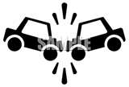
Changing Behavior - Space
When passing vehicles in adjacent lanes be particularly careful.
A vehicle may pull out in front of you or into your side:
And you may have no space to move to!
In which case your automatic defensive reaction may well be to swerve into another vehicle – possibly head-on.

Slide 78
Changing Behavior – Space
Passing using the oncoming traffic lane is very dangerous.
In 2007 67% (2/3) of ALL fatal crashes took place on two lane undivided roads.
Always a bad move unless the vehicle in front of you is driving significantly below the speed limit.
You must be 100 % positive there is no traffic for over ½ mile or more.

Slide 79
Changing Behavior - Space
Passing in the oncoming lane:
At 60 mph converging vehicles are approaching each other at 120 mph.
That equals 176 feet/sec.
Driving 60 mph passing a vehicle going 50 mph takes 20 seconds; with oncoming traffic 40 seconds. [3600 feet/ nearly 2/3 of a mile]
If you can’t do the math, don’t do the pass!

Slide 80
Changing Behavior - Space
Passing in the oncoming lane:
You must have a clear unobstructed view of oncoming traffic.
You must have center lane stripping indicating passing is legal.
Never assume oncoming traffic sees you; they may be a distracted driver fiddling with cd’s, scolding kids, on a phone, texting, etc.
Your past successful passing is no prediction of future success IF you ignore the principles of safe, intelligent judgment when passing.

Slide 81
Changing Behavior - Space
Do not make abrupt lane changes; they are a major cause of serious crashes.
You will not have to make abrupt lane changes if you PAY ATTENTION to your driving.
Not having to make abrupt lane changes is one of the reasons for paying attention to your driving and planning your moves in advance.
Remember: you are trying to avoid all near occasions of a possible collision.
That is what a quick lane change is – a near occasion for you to collide with another vehicle. [that, opps! you didn’t see]

Slide 82
Changing Behavior - Space
Keep your vehicle where it can be seen. [daytime running lights are beneficial]
Avoid other drivers’ blind spots:
i.e., minimize your time driving in blind spot areas.
Known how to use your mirrors.
Adjust before driving.
Check rearview mirror frequently to see what is coming up behind you and how fast.
Mirrors are not enough when changing lanes or pulling into traffic:
TURN your head.

Slide 83
Changing Behavior - Space
Work Zones: [a space issue - there is less of it in these areas]
Approximately 60,000 people are injured in work zone crashes each year, mostly rear-end collisions.
PA law: vehicle headlights on in work zones.
Increase your following distance:
Remember “slinky” traffic effect.
Pay attention to stopped & slowed traffic.
Decelerate/slow down gradually so that vehicle behind you does not RAM you.

Slide 84
Changing Behavior - Space

Slide 85
Changing Behavior - Space
You will not loose any significant time by giving up space and letting other people in front of you.
If you pay attention you will find that you usually catch up to drivers who have flown by you or cut in front of you.
But it is best for you not to worry about what other drivers are doing – you should be focusing on your driving - your safety.
And your Safety requires Space.

Slide 86
Changing Behavior – Aggressive Driving
You will greatly reduce your vulnerability to aggressive drivers by using safe driving practices.
Pay attention.
Be sober (so that you will be best able to react to them).
Stay away from them (Space!).
Don’t speed (the faster you are moving the less time you have to react).
Remember formula: increased speed=increased damage.
P.A.S.S.

Slide 87
Changing Behavior - Aggressive Driving
To fully lower the odds of crashing our vehicles, we need to work to eliminate our own aggressive diving habits – and we all have them.
We speed.
DON’T!
We make abrupt lane changes.
Pay attention and you won’t have to!
We tailgate sometimes/all the time.
Don’t do it: EVER.
We get angry at other drivers.
Manage it. And do not allow other peoples’ bad driving to influence your driving.

Slide 88
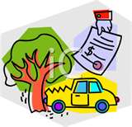
Changing Behavior – Aggressive Driving
When we get frustrated (stopped or slow moving traffic) we get angry.
We also get behind the wheel with personal frustrations (work, romance, money, family) that make us angry.
You cannot afford to let your angry feelings influence your driving.
But they will if you don’t actively find a way to control them while your behind the wheel.

Slide 89
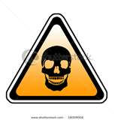
Changing Behavior – Aggressive Driving
Identify characteristics in yourself that are associated with aggressive, reckless driving:
Do you speed up to run yellow lights?
Do you speed when the road is clear and you think you will not get caught?
Do you want to ram a vehicle that cuts you off?

Slide 90
Changing Behavior – Aggressive Driving
You will not be forced as often into situations that tempt you to be an aggressive driver IF:
You plan out your driving moves in advance by paying attention to everything going on around you.
Paying attention and “proactively” avoiding trouble is your No.1 job when driving.
Why?
So that you can get home safely.

Slide 91
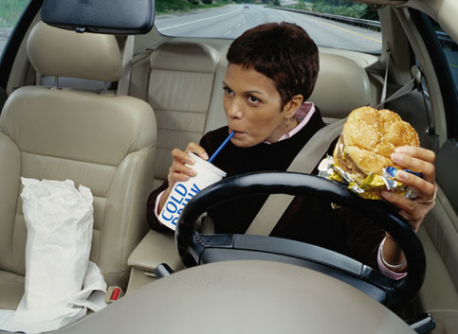
Changing Behavior – Aggressive Driving
In addition to “aggressive driving” we should say something about “passive aggressive” driving.
Eating a sandwich, shaving your face, putting on make-up, reading, fussing with ‘stuff’ on your passenger seat, talking on a cell phone – all of which can be consider as “distracted driving” are also ways of saying to the other drivers on the road:
“Up Yours!”
“S… You!”
“I don’t give a D… about you, or your place, on MY ROAD!!!”

Slide 92
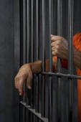
Changing Behavior - Aggressive Driving
When you’re inattention rips another person’s body apart that is indirect – or “passive” aggression.
For fatalities, it is legally referred to as MANSLAUGHTER.
The ultimate passive aggressive act.

Slide 93
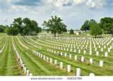
Changing Behavior - Alcohol
Keep in mind that any alcohol consumption increases your risk of being in a vehicle crash.
When this topic comes up, what most drivers I have talked to worry about is a DUI arrest.
My response is why not worry about the really serious consequences of DUI:
Brain injury
Limb amputation
Blindness
Death
Murder

Slide 94
Changing Behavior - Alcohol
Once you are under the influence your mind is not going to give you much protection from bad decisions about impaired driving.
There is nothing inherently wrong with moderate alcohol use; it can even have beneficial cardiac effects.
But not if you combine it with driving.
You loose all the cardiovascular benefits of alcohol consumption when you dump most of your blood on the floor of your wrecked automobile.

Slide 95
Changing Behavior - Alcohol

Slide 96
Changing Behavior - Alcohol
You need to make the correct decisions before you are in a position of needing to drive impaired.
Remember to eat first and get plenty of water before drinking alcohol.
Drink at home.
Drink at a location you can walk to and from.
Stay overnight.
Let someone else drive – yes, your spouse can at times be a better diver than you!
Call a cab.

Slide 97
Changing Behavior - Alcohol
What gives anyone the right to exterminate another person with their vehicle?
I know there are people who think it OK to drink and drive.
They believe murdering or crippling others is OK simply because – they didn’t really mean to do it?
Would you accept that excuse if it was YOUR child?
Have a drinking problem? Get Help.
There are no excuses for vehicular homicide.

Slide 98
Changing Behavior – Alcohol drunk & speeding driver

Slide 99
Changing Behavior - Alcohol
You say you don’t care?
How do you feel about prison life?
Did you know that the legal system is now geared to tap your wallet for the rest of your life if you can’t afford a multi-million dollar cash settlement?
Can you afford a million dollar cash settlement?
The victim you didn’t care about will have you paying until you have nothing left to hand over.
Stop making excuses for dangerously irresponsible behavior and start using your brain.

Slide 100
Changing Behavior – Alcohol [click on video icon below]

Slide 101
Changing Behavior - Speeding
A little bit of increase in your vehicle’s speed significantly increases your collision/injury/fatality risk.
The faster you go the less time you have to react - even if you are paying attention.
Speed lengthens stopping distance.
Speed increases impact consequences; e.g., greater brain damage, amputation vs. repair.

Slide 102
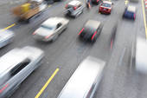
Changing Behavior - Speeding
Clearly we speed when it appears to suit OUR purpose:
I am late for work.
My kid is waiting to be picked up at school.
I want to get to the shore as fast as possible.

Slide 103
Changing Behavior - Speeding
Speeding does not accomplish your purpose of an earlier arrival in local traffic.
Prolonged highway speeding in limited traffic may gain you a few minutes, but:
You are significantly elevating your risk of a serious crash,
Or an increase in your insurance linked to your expensive speeding ticket,
Or a lifetime of payments following a civil court action against you.
And still your arrival time is only slightly altered.
Also, you may never get to your destination at all if you speed.

Slide 104
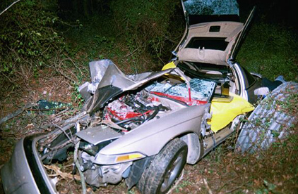
Changing Behavior - Speeding
But YOU DON”T THINK anything BAD could happen to you!?
Why not?
Think you’re “Special” when it comes to crashes?
Think again.
Ever notice that old people never drive over the speed limit?
That is how they got to be so old!!

Slide 105
Changing Behavior - Attention
Lack of Attention while driving is the most important point to remember in this class .
The sooner you start paying attention, the sooner you will begin to lower your odds of ending up in the city morgue.
The question is: how do you combat your distracted driving habits?
You need to remember the categories of behaviors that cause distracted driving, and NOT engage in those behaviors.

Slide 106
Changing Behavior - Attention
Repeating the most common distractions:
The cell phone (hands-free included):
Before your vehicle starts moving turn it off. Answer voice mail/make calls when you stop.
Just because you are used to talking on cell phone while driving, and feel you must be in touch is no excuse for this dangerous STUPID behavior.
This is not being mean, this is not being impractical; this is telling you what you need to know to remain alive and healthy.
Cell phone users need to get their ears and attention off the phone and hear the car crash in their future.

Slide 107
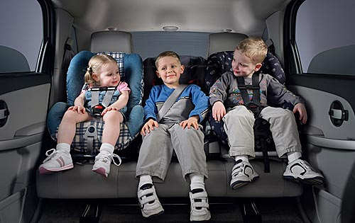
Changing Behavior - Attention
Infants and children:
Should be strapped in, and movable objects should be out of their reach.
In your vehicle you are a driver, not a babysitter.
Your job is to get to your destination with your children unharmed.
That requires you to be in a position where you can ignore the kids and focus on your driving.
If you take their safety for granted when driving THEY ARE NOT SAFE.

Slide 108
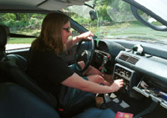
Changing Behavior - Attention
Navigation systems:
Set up the system before you start moving.
Once moving listen to the directions – don’t look at the device and don’t fiddle with it.
Fiddling/fussing with controls and objects:
This is not driving.
Do all of your adjusting, arranging chores before you start moving - including mirrors.

Slide 109
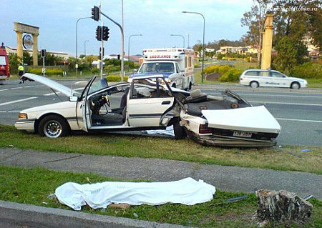
Changing Behavior to Reduce Risk
Wandering thoughts:
Work to maintain your thoughts on the road and on the traffic conditions influencing your vehicle.
Engage yourself with the business of driving and nothing else.
Conversation:
Keep it to a minimum and let passengers do most of the talking.
It is easier to not pay attention to what others have to say.

Slide 110
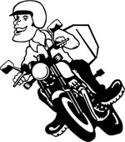
Miscellaneous Issues - Motorcycles
Motorcycle fatalities are on the rise in the U.S.
1997 to 2007 motorcycle fatalities rose by 151%.
Going from 2,055 in 1997 to 5,154 in 2007.
103,000 serious injuries in 2007.
That’s approx. one out of every 50 motorcyclists.
In ten-year riding career: one in five chance of serious injury.
Motorcyclist is 37 times more likely to be killed than other vehicle drivers.
Not wearing a helmet raises the risk of death by 40 %.

Slide 111
Miscellaneous Issues - Motorcycles
The major problem with motorcycles is that vehicle drivers tend not to see them.
There are a variety of reasons for this poor vision for motorcyclists, but understand that vehicle drivers do not always register a motorcyclist (also bicyclist or pedestrian) in their brains.
Vehicle drivers are capable of running over a motorcyclist (or a pedestrian or bicyclist) without ever have seen them.
“Inattentional blindness” [Sci. News, 4-25-09] wherein your mental focus of attention is directed away from that which is right in front of your eyes.

Slide 112
Miscellaneous Issues - Motorcycles

Slide 113
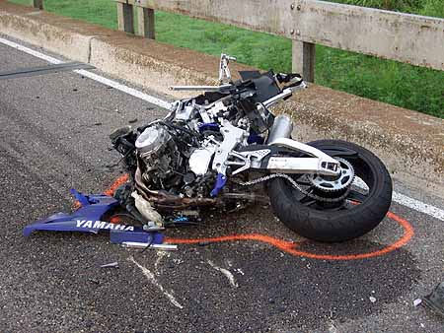
Miscellaneous Issues - Motorcycles
Forty percent of motorcycle crashes involve another vehicle turning left in front of the motorcycle:
A motorcycle may be in your blind spot when you turn left.
Remember to turn your head for all moves to the left. [in addition to using your mirrors]
Also, motorcycles stop much more quickly than car or trucks, so you need to leave more space in front of you when following one.
Their presence on the road should raise a giant red flag for you –DANGER!

Slide 114
Miscellaneous Issues – Seat Belts
Seatbelts not only keep you from hitting the steering wheel, dashboard, and windshield –
They also keep occupants from being ejected from the vehicle.
Being ejected from a crash vehicle usually kills.
Nonetheless some drivers insist on not wearing a seat beat because they report they believe that they have better chance of surviving a crash if they are “thrown clear.”
They’re wrong – dead wrong.

Slide 115
Miscellaneous Issues – Seat Belts Driver ejected through roof

Slide 116
Miscellaneous Issues – Seat Belts [click on video icon below; second scene only – what happens when you don’t wear a seat belt]

Slide 117
Miscellaneous Issues – Seat Belts
The good news is that most divers and occupants now wear them.
83% in 2008, up from 60% in 1994.
Seatbelt use is significantly higher in states that require their use.
It is important to understand that vehicle airbags are only useful (and not very useful at that) when used in conjunction with a seatbelt.

Slide 118
Miscellaneous Issues – Seat Belts
It’s clear a seatbelt, properly worn, will protect you in a crash; so why do people grumble about them and not wear them?
Many people think they are restrictive and uncomfortable.
That’s the whole idea – restrict you so that you don’t get your head bashed in!!
When you put on your seatbelt take the time to properly adjust it.
There is no reason for it to be uncomfortable or restrictive if you move correctly.
Do all of your arranging of “stuff” before you start moving, and then belt-up.

Slide 119
Miscellaneous Issues – Seat Belts
Seat belt laws vary state to state; here are Pennsylvania’s:
Anyone in front seat must be belted.
Ages 8 to 18 must be belted.
Ages 4 to 8 must be buckled into approved child booster seat, secured by seat belt.
Ages 4 and younger must use child restraint seat secured by seat belt or LATCH system (new vehicles).
Infants less than 20 lbs or under one year of age must be placed in a rear facing child safety seat, in backseat of vehicle (never in the front seat).

Slide 120
Miscellaneous Issues – Seat Belts

Slide 121
Miscellaneous Issues - Airbags
Without a seatbelt airbags do more harm than good.
Thus, if airbags are installed in your vehicle, you had better fasten your seatbelt.
Unless you want even a low speed crash (12 mph) to possibly snap your spine at the neck and leave you a quadriplegic.
Some people think (or like to think) airbags are a substitute for a seat belt.
They’re NOT!

Slide 122
Miscellaneous Issues - Airbags
Airbags increase seatbelt effectiveness slightly, approximately 5%.
However, airbags are only protective for men (11.6% decrease in net harm).
Airbags injure and kill more women (9.2% increase in net harm) then they save!
Short women are 15 times more likely to be killed by an airbag than the average size person.
Airbags have a record of killing vehicle occupants in low severity crashes (primarily women and children).

Slide 123
Miscellaneous Issues - Airbags
Airbags are now realized to be enough of a danger that state driver’s manuals have warnings regarding them.
PA driver’s manual states, “Driver and front passenger seats should be moved back as far as practical, particularly for short people….to be safe, in case the air bag deploys, you should be at least 10 inches away from the steering wheel.”
AAA’s safety course states; “Sitting too close to the steering wheel increases the risk of being seriously injured in a crash or by the airbag.”
Some can be turned off on passenger side, but never on driver’s side.

Slide 124
Miscellaneous Issues – Daytime Lights
Studies have shown that daytime “running” lights reduce collisions approximately 15%.
Some, maybe most, insurance companies give a discount for vehicles equipped with them.
An option worth buying if not standard equipment.
May be available for installation on vehicle you are currently driving; check with dealer.
If you don’t have them, turn on your parking lights during daylight hours.
Just remember to turn them off.

Slide 125
Miscellaneous Issues - Intersections
There are a high percentage of serious collisions at intersections so be fully attentive and act intelligently.
When the traffic light turns green look both ways (don’t expect moving cars to stop).
Even with a green light, you must yield to pedestrians AND other vehicles in the intersection.
PA traffic law does not give anyone the right of way at an intersection:
Law only states who must YIELD.
If another driver breaks the law and fails to yield you the right of way, you are still required to stop as necessary to avoid a collision.

Slide 126
Miscellaneous Issues – Intersections [click on video icon below: why you need to be alert and watchful entering every intersection]

Slide 127
Miscellaneous Issues - Intersections
Don’t accelerate into the intersection too quickly:
Some nut may still be trying to beat the light.
Or, more likely, not paying attention.
When the light turns yellow - Stop! when reasonably possible.
Yellow does not mean accelerate.
If you accelerate to beat the light: Dumb may meet Dumber!
You should always be ready to stop when approaching a green traffic light because you should be anticipating it will turn red.
That is what green lights do - turn red, ALWAYS.

Slide 128
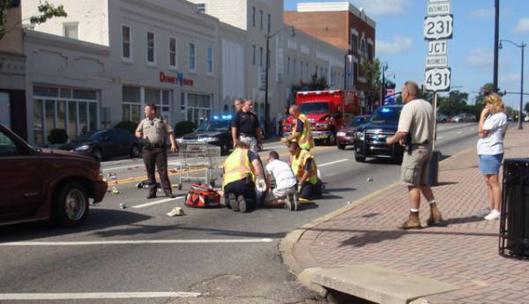
Miscellaneous Issues - Intersections
Use Your Head
Turn it - look both ways – TWICE.
One look can miss an object.
That “object” could be a person.
Remember people don’t always walk were they should. Especially people without vehicles.

Slide 129
Miscellaneous Issues – Turn Signals
How many use their blinkers whenever you turn? Sometimes? Never?
Why would you not use them at all times?
Remember that you can never be sure there is not a vehicle near you.
PA requires turn signal use 350 feet before turn when driving over 35 mph, and100 feet before turn driving under 35 mph.
Just because a vehicle’s blinker is on does not guarantee that they will turn.
Pay attention, be prepared.

Slide 130
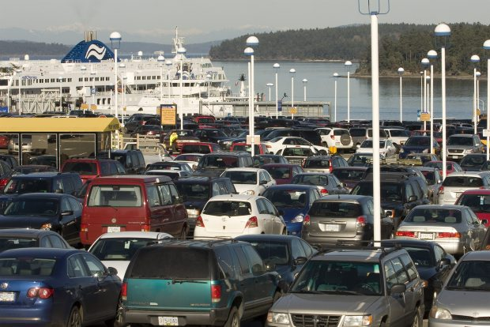
Miscellaneous Issues – Parking Lots
In Parking Lots:
Drive slowly.
Do expect any vehicle in your path to be about to pull out.
Don’t expect other drivers to see you.
Don’t even expect them to look as they pull out in front of you.

Slide 131
Miscellaneous Issues – Driving Skills
Cover the brake: remove foot from accelerator and place over the brake in anticipation of stopping.
This reduces your reaction time when braking.
Practice it when traffic is stopped ahead of you, you are approaching a traffic light, or entering into a curve.
Of course you must first be paying attention to your driving and looking ahead.

Slide 132
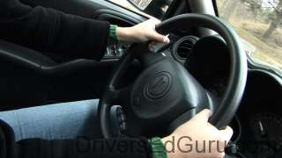
Miscellaneous Issues – Driving Skills
Steer with two hands:
You cannot react properly with one hand in an emergency.
Not expecting the need for an emergency reaction?
You cannot anticipate an emergency!!
Place your hands at 8 and 4 o’clock on the wheel.
And, if you have both hands on the wheel you won’t be fiddling with non-driving activities.

Slide 133
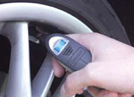
Miscellaneous Issues – Driving Skills
Correct tire pressure:
Gives you better control of your vehicle.
Reduces fuel consumption.
Reduces tire wear.
And worn tires give a driver less control.

Slide 134
Miscellaneous Issues – Driving Skills
Backing up:
Absolutely requires extra care and attention.
Hundreds of kids are run over by their own family each year right on their own driveways.
As well as in parking lots and on the street.

Slide 135
Miscellaneous Issues – Driving Skills
Many drivers believe they have better driving skills than the “average” driver.
The fact that such beliefs are mathematically impossible seems not to matter to anyone.
What should matter to everyone is that believing you are a better than average driver will put you at greater risk.
The less confident driver will usually be more attentive, deliberate and cautious.
And will be more creative in finding ways to be safe.
The over confident driver lacks a reasoned caution that will tend to prevent risky driving behaviors.

Slide 136
Miscellaneous Issues – Driving Skills
Safe driving today is all about being intelligently cautious, not confident.
No one has any reason to be confident about arriving home safely given the millions of collisions each year on our roads.
You think you are in control of the hazards around you on the road?
You think your quick, catlike reactions are going to protect you?
You could not be more wrong.

Slide 137
Miscellaneous Issues – Driving Skills
When you finally do get unexpectedly whacked on the road, you will see how little control you had over the event.
The comment I have heard most often is: “It all happened so fast!!”
I do not accept that as an excuse and neither should you.
We seem to view vehicle crashes as just part of our way of life. THEY ARE NOT.
Vehicle crashes are a measure of our lack of training or apathy as drivers, but they are not natural or normal.
AND they can be avoided.

Slide 138
Miscellaneous Issues – Driving Skills
Many drivers have crash free adult driving records.
They practice good driving habits (P.A.S.S.)
You think they are just lucky?
As professional golfers are often heard to say –
“The more I practice the luckier I get.”

Slide 139
Miscellaneous Issues – Driving Skills
Driving is primarily a visual activity, which is why the state repeatedly gives you an eye test.
Anytime you take your eyes off the road you are at an immediate risk of a crash.
Can you take them off the road to check rearview mirrors?
Of course you can, that move only takes a fraction of a second.
Can you take your eyes off the road to root through your CD collection, or lunch bag?
NO!

Slide 140
Miscellaneous Issues – Driving Skills
When driving you must keep your eyes on the road constantly scanning for hazards.
When you practice that long enough it becomes almost automatic.
If you think that much attention given to your driving sounds like too much work –
THINK AGAIN!
Failure to pay full attention will lead to consequences much less desirable than having had to pay attention while driving.
You do want to get to your destination in one piece, right?

Slide 141
Miscellaneous Issues - Habit
The truth is that none of us give our total attention to our driving - we are often on autopilot.
Why?
HABIT
Habit explains a lot of what people do.
Each one of us has to varying degrees a combination of good and bad habits while driving.
The whole purpose of this class is to strengthen your good habits, add some new ones, and eliminate your bad habits.

Slide 142
Miscellaneous Issues – Habit
Because bad habits are “habits;” i.e., ingrained, automatic and persistent, you are going to have to work consistently and persistently on losing them.
A driver loses bad habits by replacing them with good driving habits.
We have already covered the basic good habits necessary for safe diving; they are clear and straightforward.
Pay Attention! (keep your eyes and mind on the road)
Alcohol restraint
Speed control
Space around your vehicle
P.A.S.S.!

Slide 143
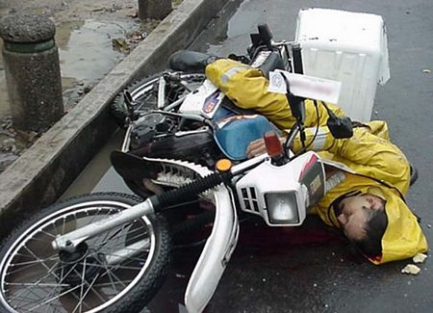
Misc. - Modifying Habitual Behavior
The problem in transforming oneself into a safe driver is that:
Habitual behavior is hard to change.
Your current driving situation is likely to be this:
You are used to driving and not crashing, or at least not being killed or dismembered.
You are used to diving on automatic pilot with your mind on a variety of things: the kids, the spouse, your job, health, etc.
The last thing you are probably thinking about is your safety or that of other drivers.

Slide 144
Misc. - Modifying Habitual Behavior
You need to get your mind off the non-driving items and onto what really matters at the moment – YOUR DRIVING.
How are you actually going to do that?
How are you going to remember P.A.S.S. with all those other issues on your mind?
You will need a TRIGGER.
When you get behind the wheel you need a visual reminder that will take you back to P.A.S.S. (like a string tied around your finger).

Slide 145
Misc. - Modifying Habitual Behavior
So what is important enough to you to get you to modify your driving habits?
What is your memory tickler going to be?
It needs to be something concrete and visible.
When you see it must remind you of P.A.S.S. [Or any acronym you invent for yourself]

Slide 146
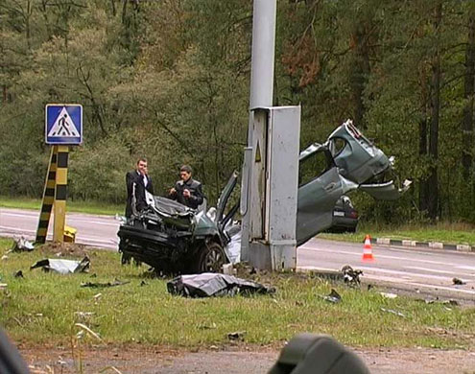
Misc. - Modifying Habitual Behavior
The important point in all of this is that you will need a reminder to change your habits.
Anyone would, because safe driving is not a habit anyone fully possesses.
Nor is it the first thing on our minds.
Please! at least give yourself a chance to remember what is important when you are behind the wheel.
An automobile crash does not have to be in your future, but right now it is.

Slide 147
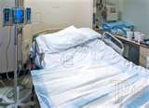
Misc. - Modifying Habitual Behavior
Place a visible reminder in your vehicle within 24 hours of leaving this class.
Without a visible, meaningful reminder no driver is going to be able to remember P.A.S.S. each time they get behind the wheel, nor while driving.
At the end of the day you do want to sleep in your own bed, right?

Slide 148
Driver Safety - Review
Conduct a thorough visual search ahead of your path of travel.
Avoid distractions. [refer to your handouts]
Never tailgate – always have an adequate cushion of SPACE ahead of your vehicle regardless of what other drivers are doing.
Have a plan for the road ahead.
Position your vehicle with space to the sides whenever possible.
Drive smart – try to anticipate the possible actions of other drivers.

Slide 149
Driver Safety - Review
See and be seen – use daytime running lights and always use your blinkers.
Do not drive where (or when) you cannot see.
Be a considerate driver.
Obey all traffic controls. [that includes Speed!]
Maintain your vehicle and tires in good condition.
Consider what might happen before it does happen.
Pay Attention! Pay Attention! Pay Attention!!!!!!

Slide 150
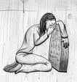
Driver Safety - Conclusion
We are each of us lulled into “driving-safety-complacence” by a daily reinforced perception that collisions don’t happen TO US.
They do in fact happen to us, but not often enough to always get our attention.
Thus we don’t think we need to act to prevent one.
Root out your false sense of being safe behind the wheel just because you have not had a collision recently.
It only takes one crash to ruin your life or the life of another person.

Slide 151
Driver Safety – Conclusion [click on video icon below]

Slide 152
Driver Safety - Review
To be a first-rate safe driver you need to anticipate having a crash.
A collision is out there now on the road waiting for you; maybe deadly, maybe not, but definitely at least damaging to your vehicle and your wallet.
An attitude/belief that it won’t happen “to me” puts you at higher risk every time you get behind the wheel.
And don’t forget about the lawyers.
They are out there waiting for you to crash.
They want part of your paycheck – for as long as you get one .

Slide 153
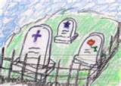
Driver Safety - Review
Ultimately the question you must ask yourself is:
Do I care enough about crippling/killing myself, or someone else, to make the EFFORT needed to become a first rate safe driver.
After the terrible fact of a deadly or crippling collision; after you have ruined a life (or lives) – including your own –
It is TOO LATE!! to come to the conclusion that: “GEE, I guess it would have been worth the effort to work on being a better driver.”

Slide 154
Driver Safety – Conclusion [click on video icon below]

Slide 155
Driver Safety - Conclusion
You truly need to consider YOUR future on our roadways: NOW – ToDay!!!
Practice the major factors in crash prevention:
Pay Attention
Alcohol restraint.
Speed control
Space between vehicles

Slide 156
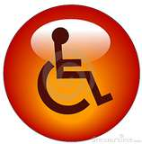
Driver Safety
“We have met the enemy and he is us.” Pogo
Questions? Comments?
Email me: trdfcu@juno.com

